Slide 1
Deep Reinforcement Learning for Trading
Hao Wang, Haolan Cheng, Yuting Lun

Slide 2
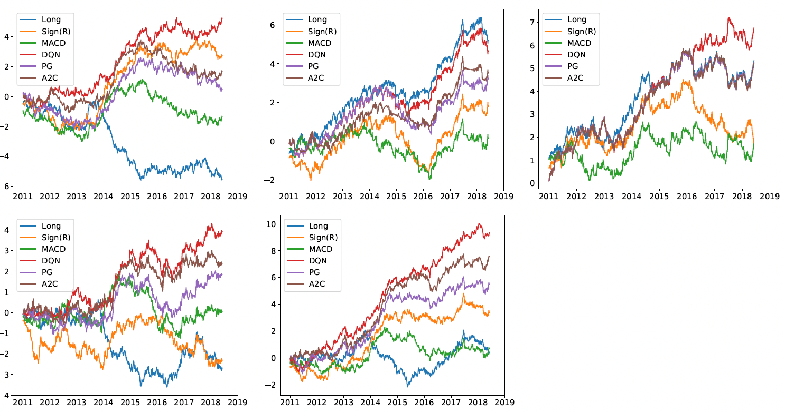
Summary of Original Paper
Traditional Methods
Proposed RL Methods
Fundamental & Technical Analysis: Often lack precise timing for entering and exiting trades, leading to potential drawdowns.
Time-Series Momentum: Highly effective in trending markets, but severely vulnerable to sideways or mean-reverting markets (like FX).
Classical RL (Q-Learning): Frequently relies on discrete action spaces (fully long/short), which is highly risky during volatile periods.
Deep Q-Networks (DQN): Evaluates the value of discrete actions in a given state.
Policy Gradients (PG): Optimizes the policy directly, useful for continuous action spaces.
Advantage Actor-Critic (A2C): Updates policies in real-time by combining an 'actor' network with a 'critic' network.
Figure 1: Cumulative trade returns.
First row: commodity, equity index and fixed income;
Second row: FX and the portfolio of using all contracts.

Slide 3
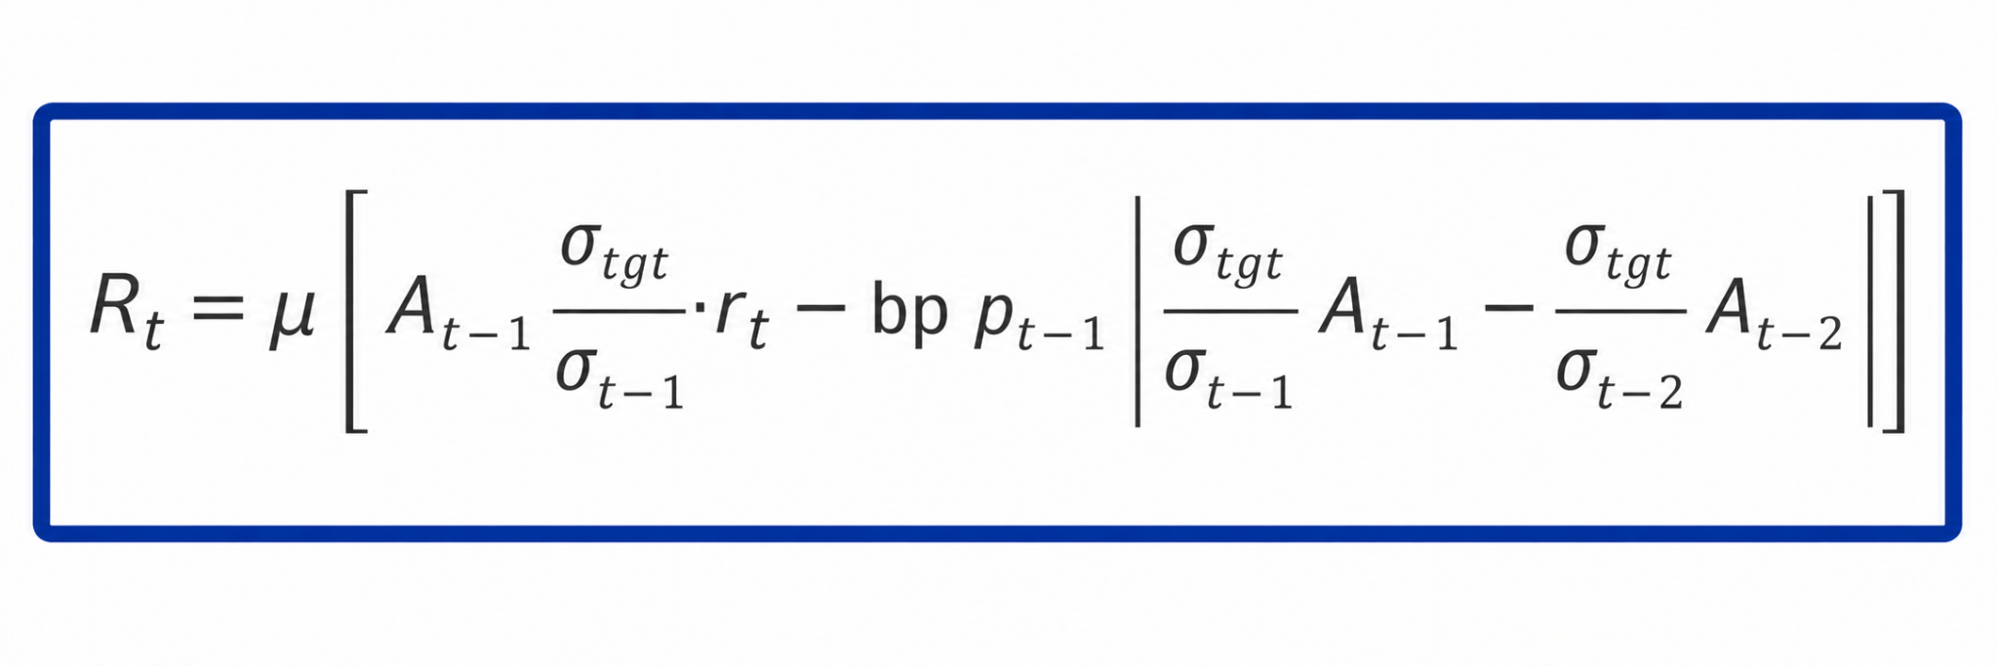
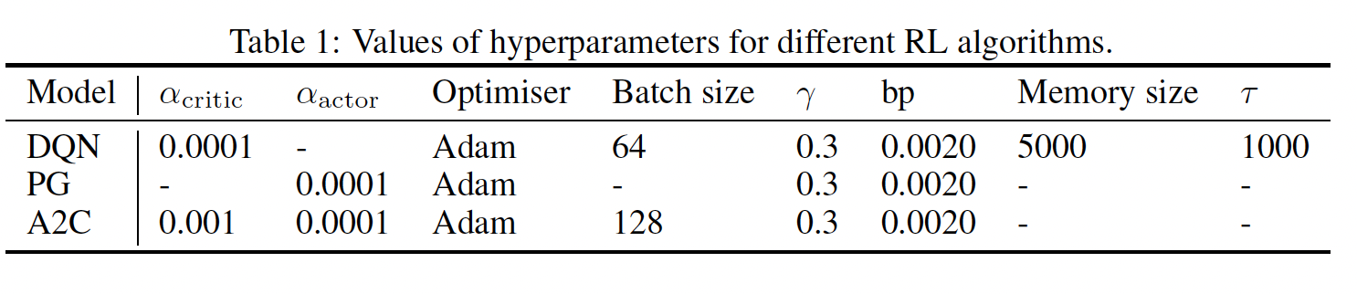
Summary of Original Paper
1. Data
2. Methodology
3. Evaluation Metrics
50 most liquid futures contracts (2011-2019).
Commodities (25)
Equity Indices (11)
Fixed Income (5)
Forex (9)
Markov Decision Process (MDP) formulation.
State: 60-day lookback (Price, Returns, MACD, RSI).
Action: Target orders [-1, 1].
Reward: Volatility-scaled additive profits.
Portfolio-level performance assessment.
Annualised Expected Return
Sharpe & Sortino Ratios
Maximum Drawdown (MDD)
Calmar Ratio
Market State
Price, Vol, MACD
DRL Agent
(Actor-Critic LSTM)
Action Portfolio Weights

Slide 4
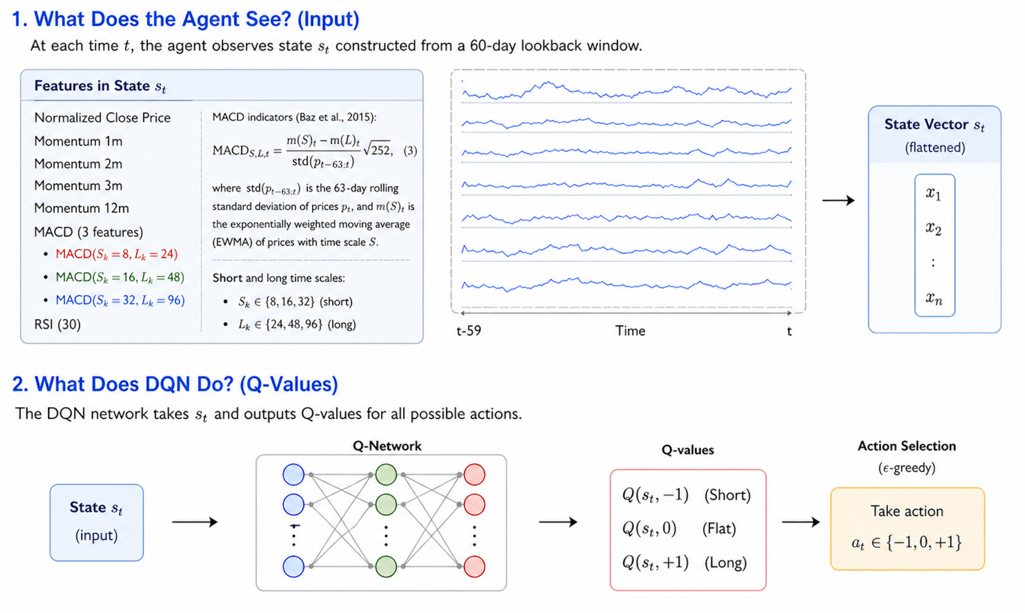
DQN(I)

Slide 5
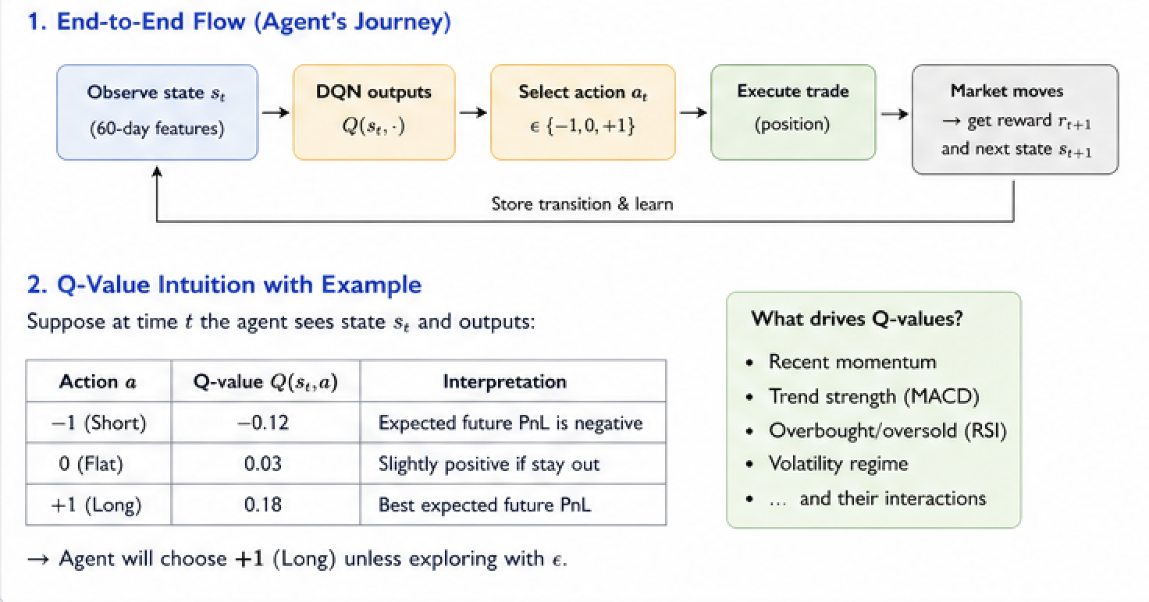
DQN(II)

Slide 6
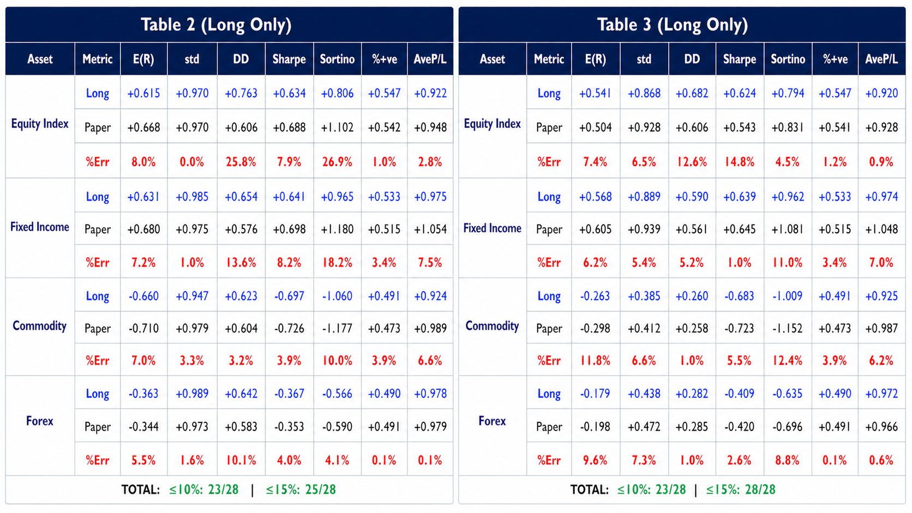
Current Progress of the replication of risk diagnostics

Slide 7








How A2C Works
1. Input past 60-day feature sequence
2. Use LSTM to encode these features into hidden state
3. Actor samples action _t ~ π(a| | )
4. Environment takes action a_t according to current state , then it produces reward R_t and evolves to next state
5. Use LSTM to encode into and calulate V( ), V( )
6. Calculating Advantage through
7. Update Critic by minimising TD error
8. Update Actor by maximising objective function

Slide 8
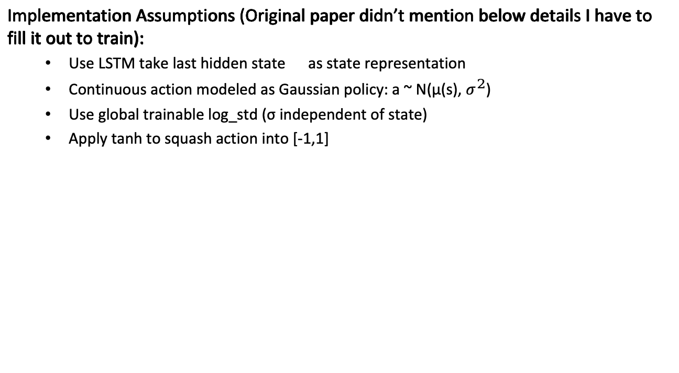
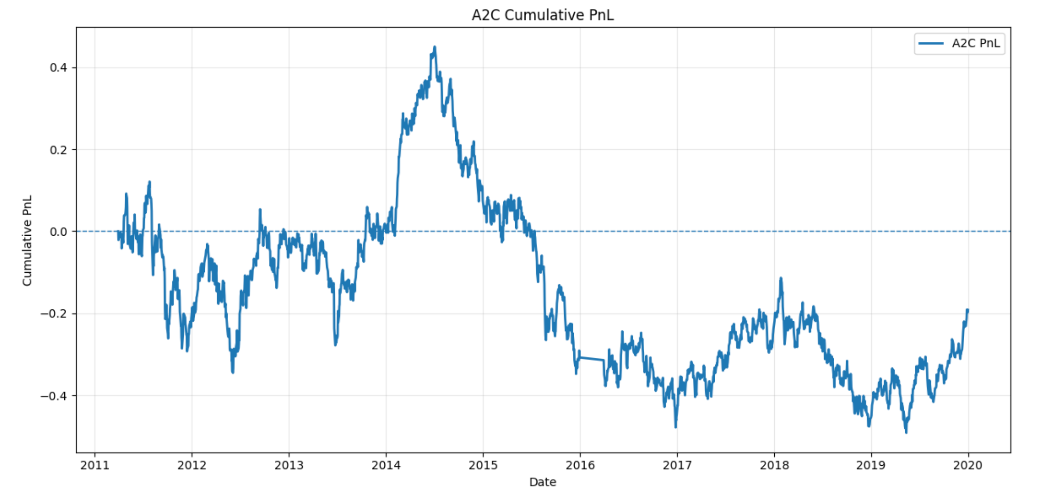
Assumptions and A2C Results

Slide 9
Reasons of Differences
 |  | E(R) | Std(R) | DD | Sharpe | Sortino | MDD | Calmar | % +Ret | Ave.P/L
(Commodity) | Ours | -0.19 | 0.29 | 0.19 | -0.65 | -0.96 | 2.02 | -0.09 | 0.50 | 0.91
 | Paper | 0.07 | 0.16 | 0.10 | 0.44 | 0.73 | 0.10 | 0.16 | 0.49 | 1.15
 | %Err | 358% | 76% | 98% | 247% | 231% | 1937% | 157% | 2% | 21%
(Equity Index) | Ours | 0.26 | 0.50 | 0.41 | 0.53 | 0.64 | 0.88 | 0.30 | 0.55 | 0.91
 | Paper | 0.29 | 0.63 | 0.43 | 0.47 | 0.69 | 0.19 | 0.21 | 0.53 | 0.97
 | %Err | 11% | 21% | 5% | 13% | 7% | 356% | 38% | 3% | 6%
(Fixed Income) | Ours | 0.37 | 0.72 | 0.47 | 0.51 | 0.79 | 1.63 | 0.23 | 0.52 | 0.99
 | Paper | 0.85 | 1.35 | 0.81 | 0.63 | 1.06 | 0.13 | 0.40 | 0.52 | 1.04
 | %Err | 57% | 47% | 42% | 19% | 26% | 1173% | 43% | 1% | 5%
(FX) | Ours | -0.18 | 0.33 | 0.21 | -0.56 | -0.86 | 2.13 | -0.09 | 0.49 | 0.96
 | Paper | 0.16 | 0.46 | 0.27 | 0.35 | 0.59 | 0.08 | 0.19 | 0.51 | 1.03
 | %Err | 215% | 28% | 20% | 260% | 245% | 2526% | 145% | 4% | 7%
(All) | Ours | -0.02 | 0.24 | 0.17 | -0.08 | -0.12 | 0.94 | -0.02 | 0.52 | 0.93
 | Paper | 0.21 | 0.22 | 0.13 | 0.97 | 1.60 | 0.01 | 0.67 | 0.54 | 1.01
 | %Err | 109% | 7% | 23% | 108% | 107% | 10367% | 103% | 4% | 8%
Author didn’t reveal many details of training A2C model
Unknown process of how LSTM models actor and critic network
The A2C training process is somewhat unclear
A2C is sensitive to hyperparameter tunning

Slide 10
Regime Detection:
Build State Matrices
For each asset at each time point
Construct 60x9 matrix
Extract FFT Features
9 columns independent FFT → 10
Real + 10 Imaginary
= 180-dimensional vector
Load Data of 50 Contracts
GMM Clustering
n_components = 3
Fit Gaussian Mixture Model
Output Regime
Hard Labels: predict() Each time point → 0/1/2
Soft Prob: predict_proba() Each time point → P = [p0, p1, p2]

Slide 11
Training &Test
TRAINING
Get Regime Soft Probabilities predict_proab
[p0,p1,p2]
Original State Features
9-dim: price, MACD, RSI, etc.
Concatenate Augmented State 12-dim
Train Single A2C with full training data
Regime Features
3-dim: P0, P1, P2
TEST
Get Augmented State [Original 9-dim + Soft prob 3-dim] = 12 dim input
Single A2C inference LSTM automatically handles regime conditioning
Load test data
Output action directly

Slide 12
Thank you for your time!

